Slide 1


BUAN 6346.002 BIG DATA PROJECT Group 4 Truck Driver Risk Analysis
Anirudh Madhavan
Srinidhi Ls
Vishal Kanna
Pavan Katady
Hyungi Kim
Parveen Kumar
Rithwik Reddy

Slide 2
Contents
Problem Statement
Objectives
Data Flow
Tableau Table relationships
Dashboard
ML
Conclusions

Slide 3
Problem Statement
Large truck accidents remain a major concern in the United States
Injuries and fatalities caused by such accidents demand urgent attention
Trucks equipped with devices to log location and event data
Data streamed to a data center for processing and revising truck movements
Goal: Utilize data-driven insights to improve safety and prevent accidents

Slide 4
Objectives
Identify the most hazardous commercial truck drivers
Calculate and predict risk factors for driver identification based on:
Events
Total distance travelled
Average speeds
Mileage
Create a dashboard for in-depth analysis
Minimize risks associated with each driver by analyzing their data, contributing to reduced accidents involving large commercial trucks
Provide key insights and visual illustrations to support decision-making

Slide 5

Data Flow Process

Slide 6
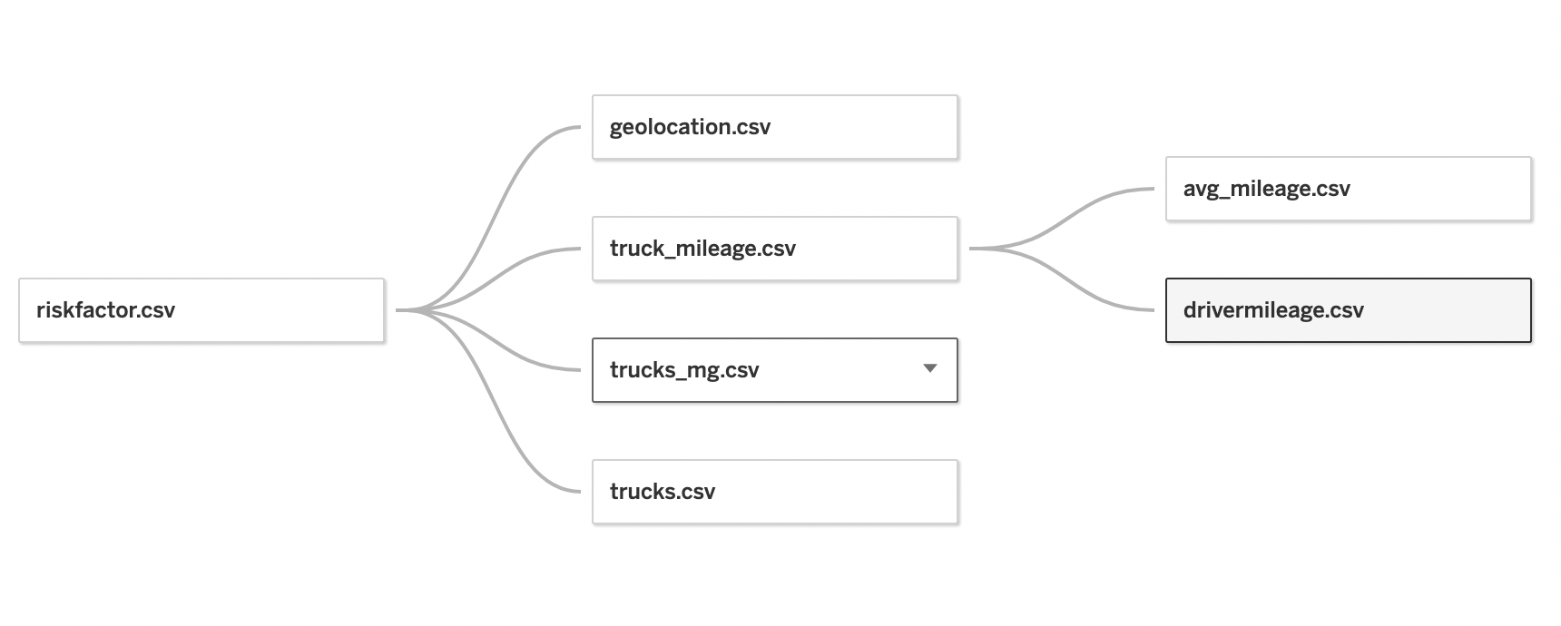
TABLEAU TABLE RELATIONSHIPS

Slide 7
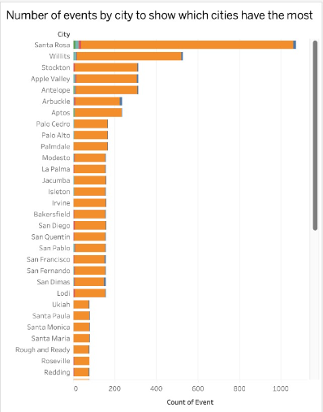
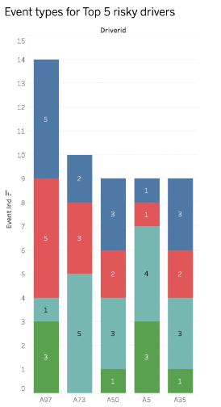
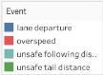
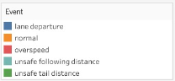
Analysis 1 – Key Insights on Violations
Santa Rosa: The most common city in the dataset with the highest number of violations, so maximum events not necessarily mean anything here
Driver A97: Committed the most violations (14 times), followed by Driver A73

Slide 8
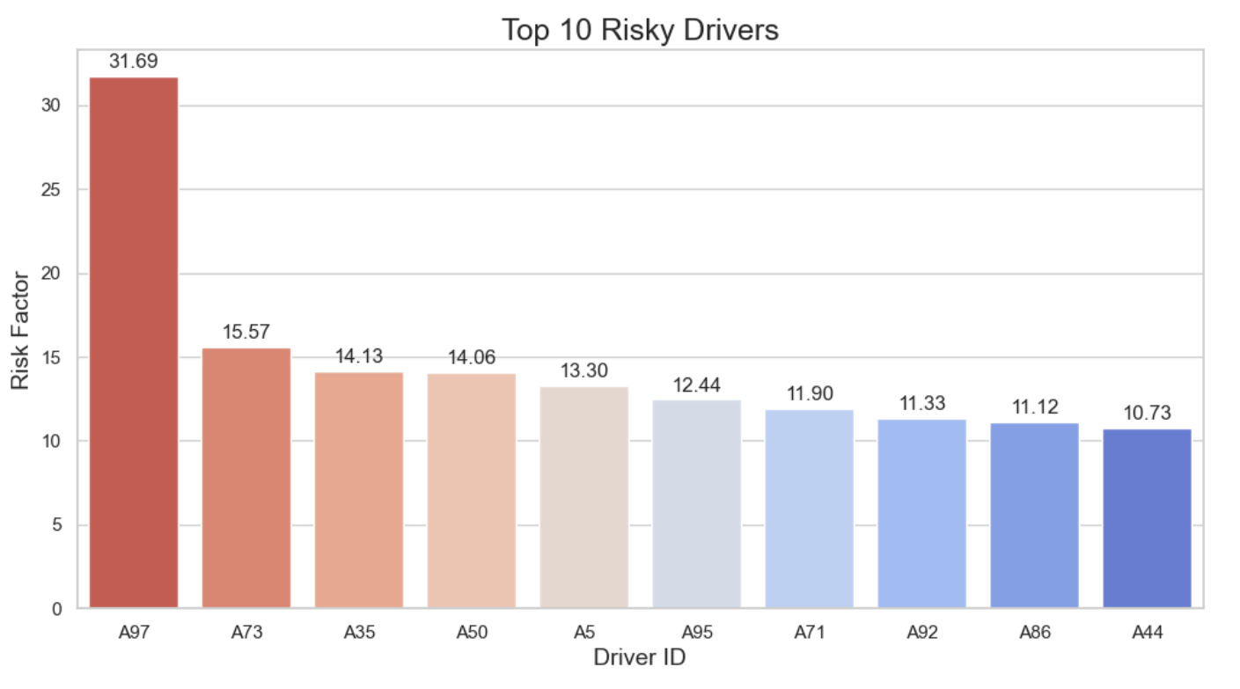
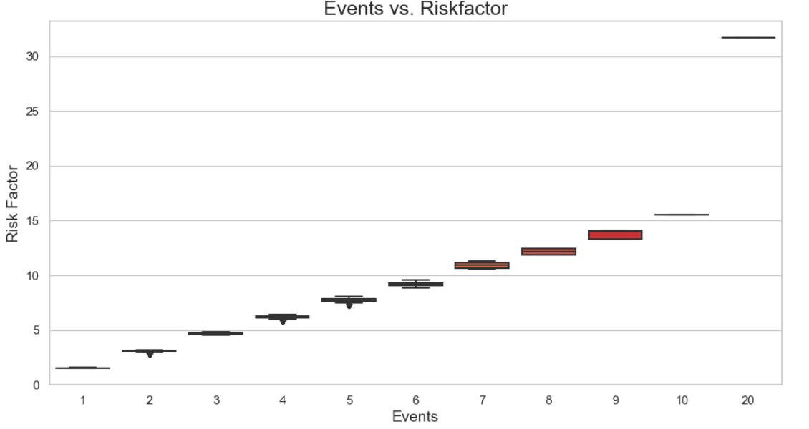
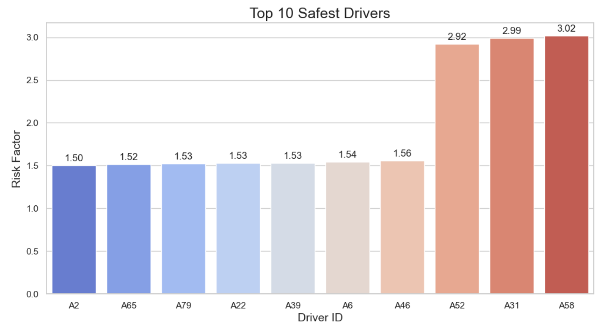
Analysis 2– Risk Factor Analysis
Risk factor is used as a parameter to categorize safe and risky drivers.
A97 has the highest risk factor- no surprise
A2 is the safest driver with risk factor- 1.50
(Considering drivers with abnormal events only !)

Slide 9
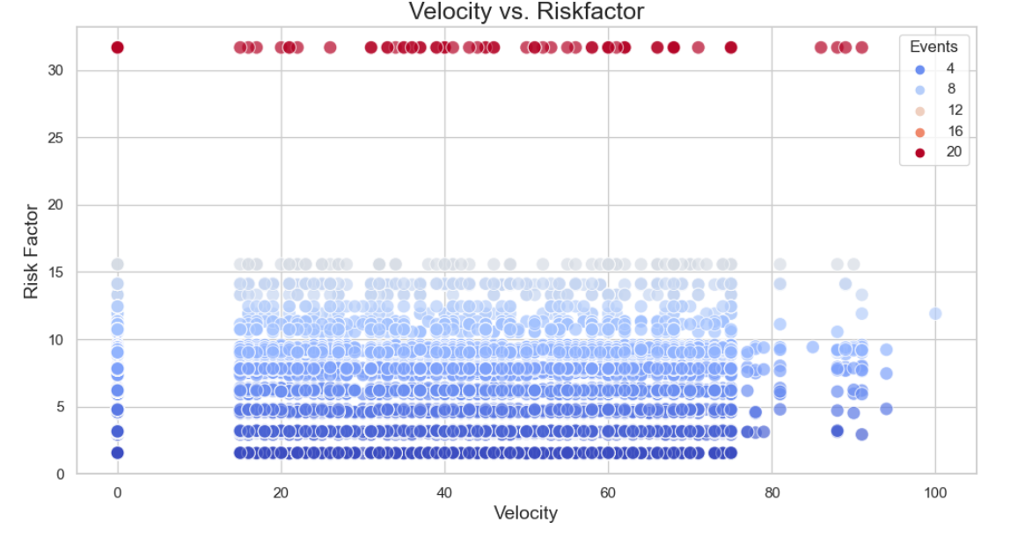
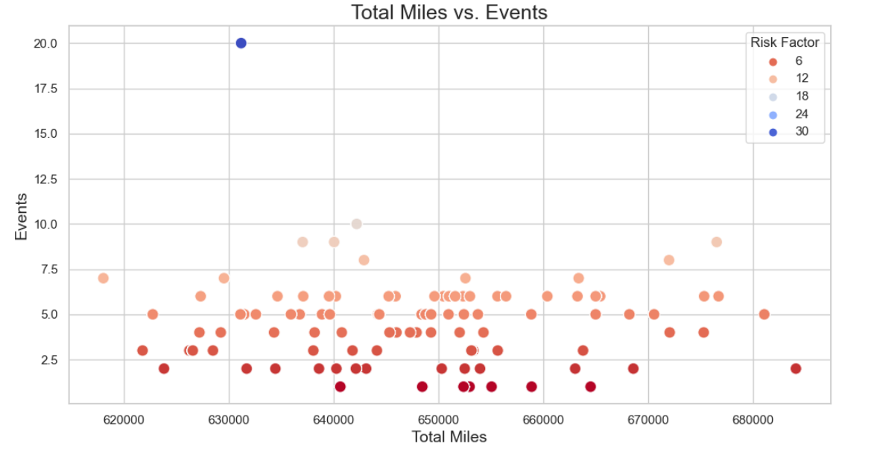
Analysis 3– Velocity vs Risk Factor Analysis
Increase in velocity does not have a significant impact on the Risk Factor.
2. Risk factor mostly ranges between 6 and 12 for total miles between 620,000 and 680,000 miles.
3. Notable outlier observed at around 630,000 total miles.

Slide 10
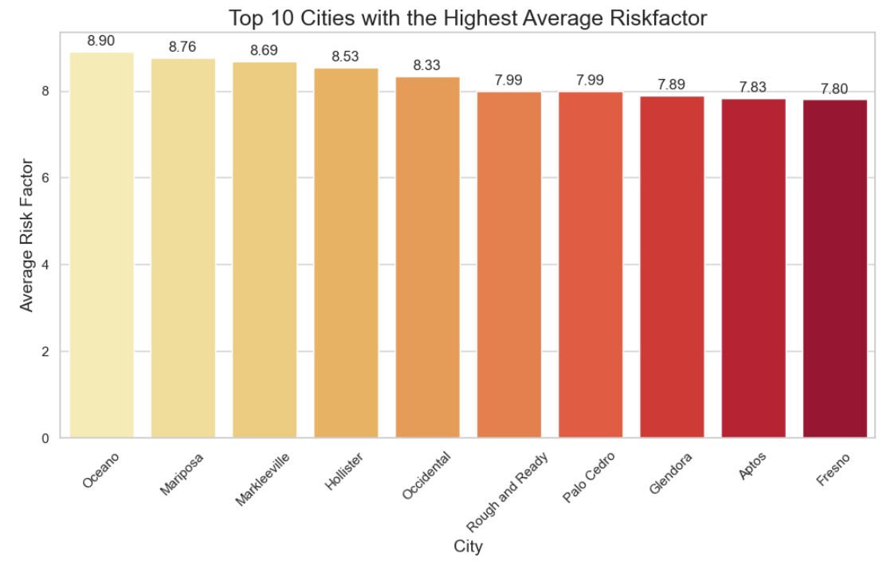
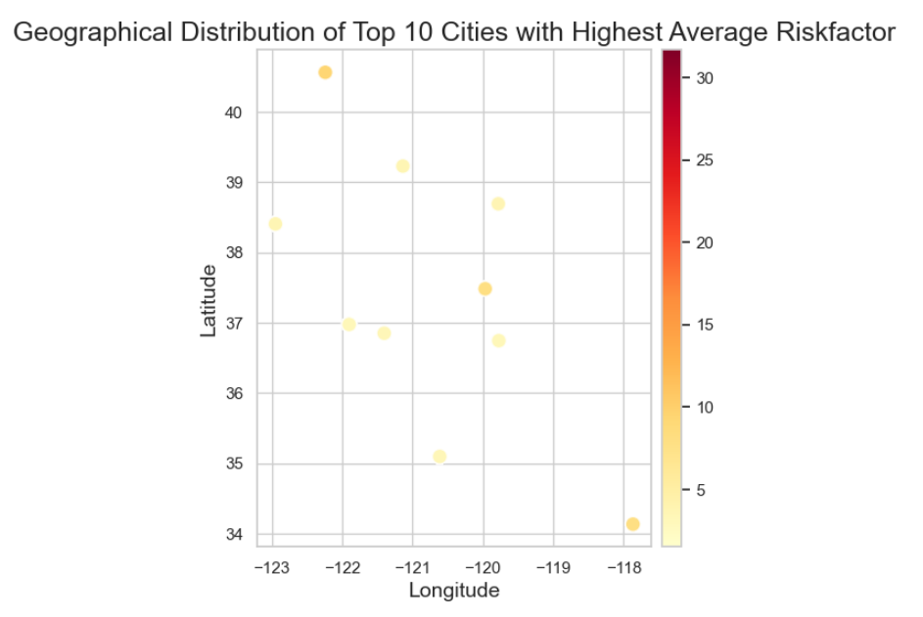
Analysis 4
Geographical distribution of top 10 cities in California with
the highest average risk factor has been represented.
Oceano is the city with the highest risk factor

Slide 11
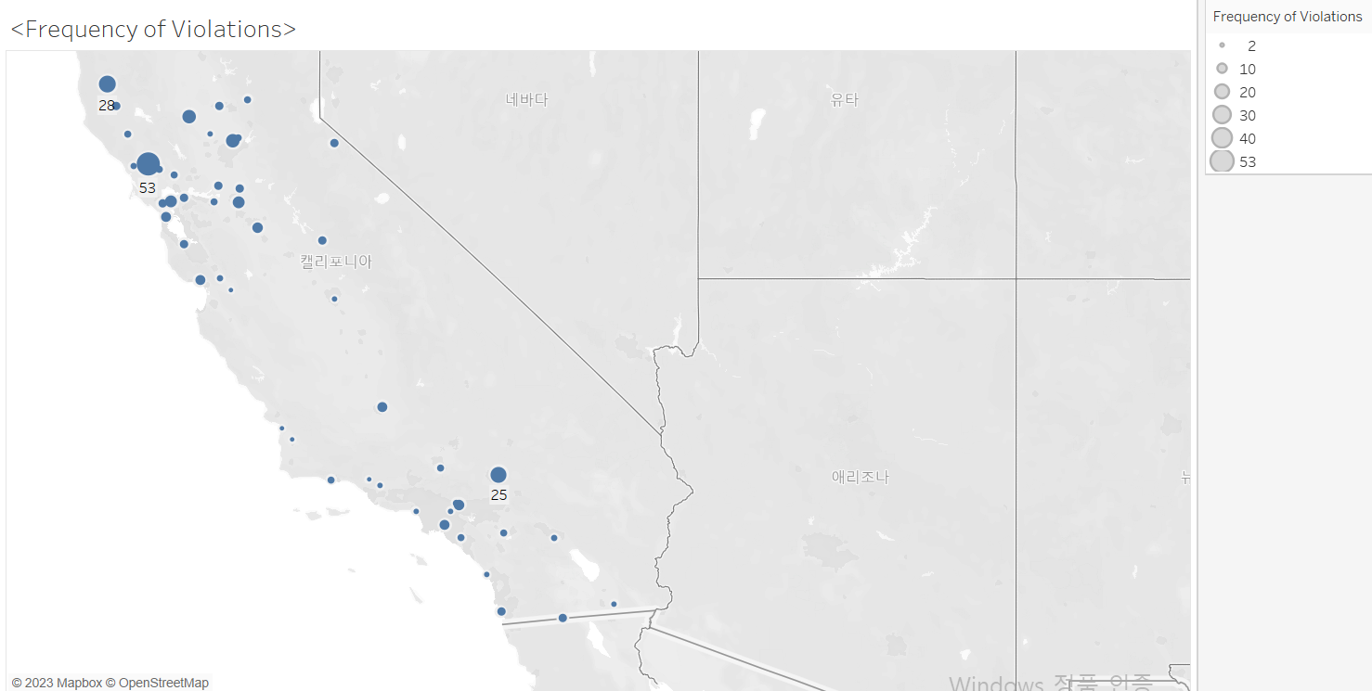
Analysis 5
This is the Frequency of Violation distribution in California. The riskiest city is Santa Rosa where 53 violations occurred in here.
And it is followed by Willits with 28 incidents and Apple Valley as 19 violations.

Slide 12
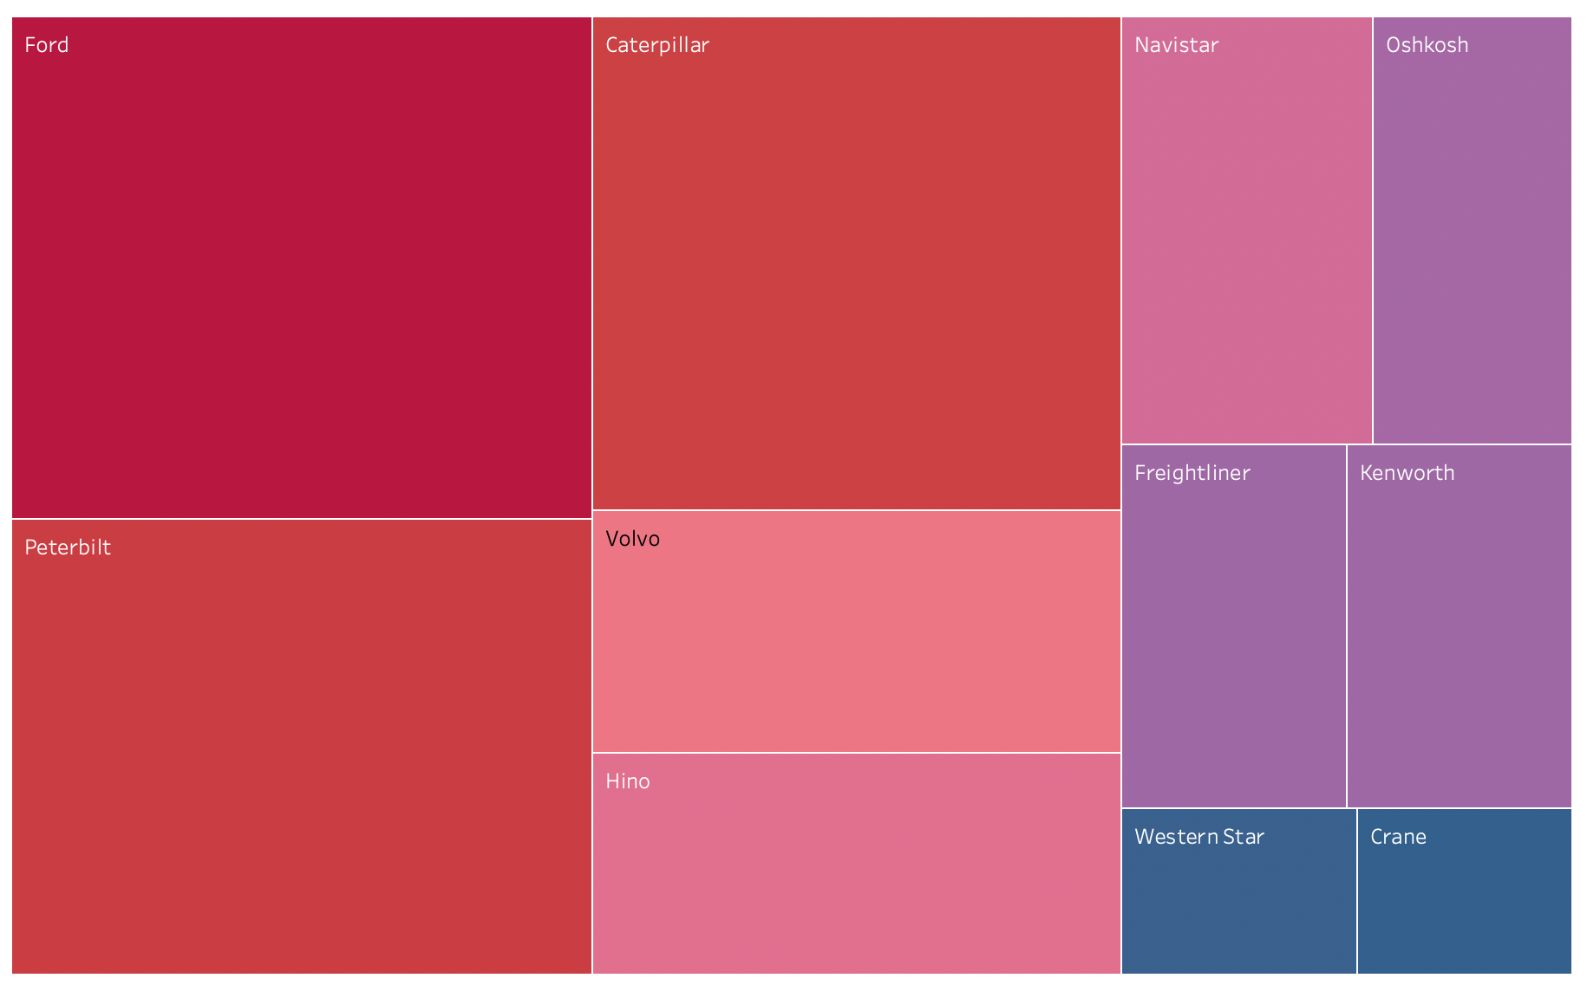
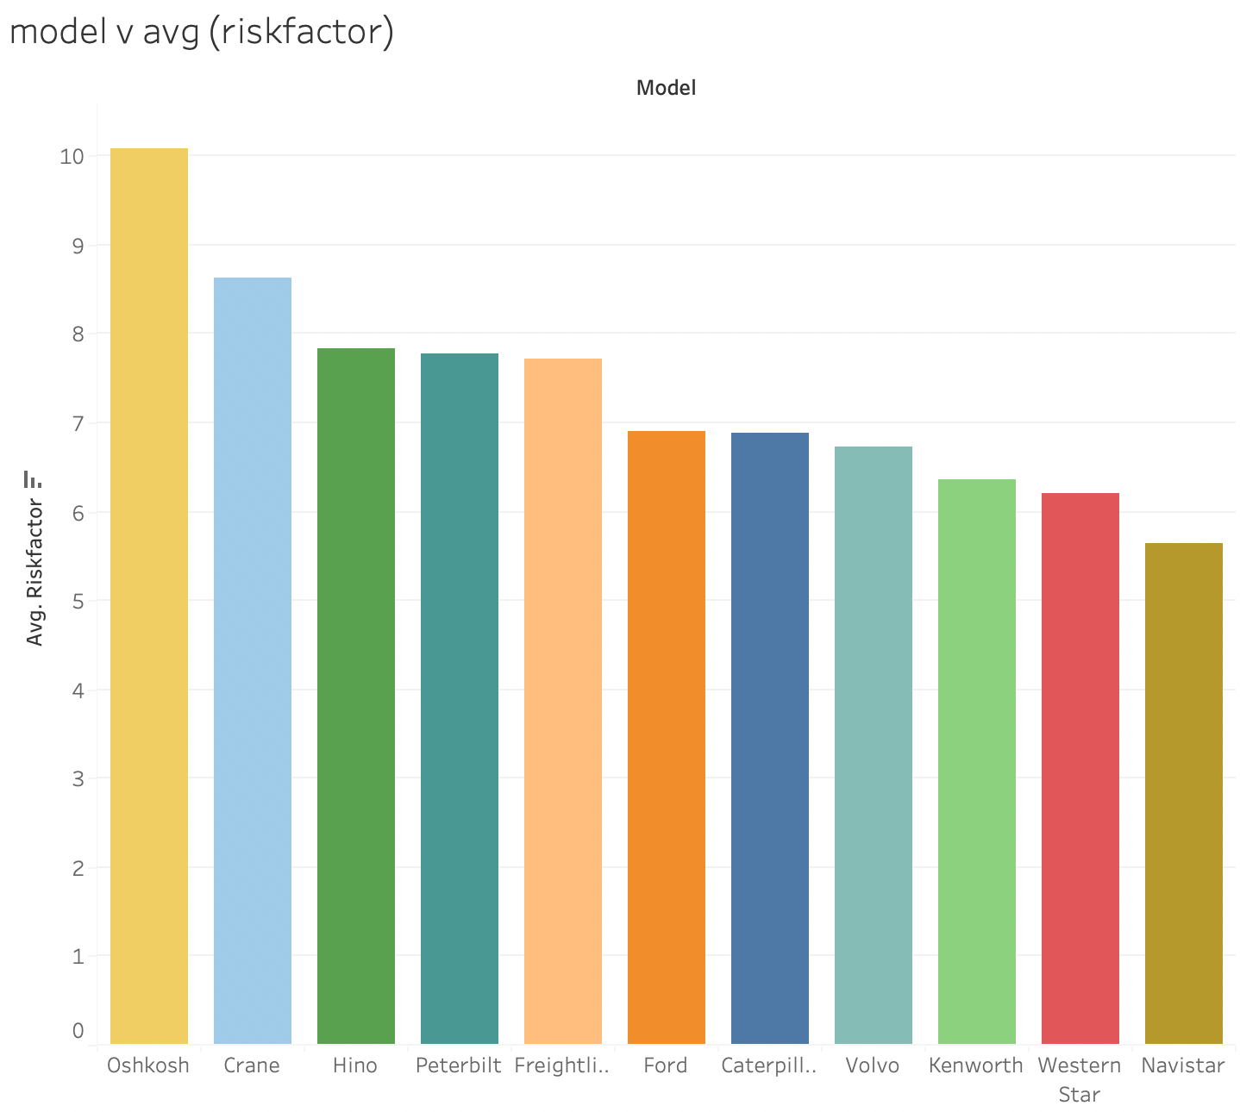
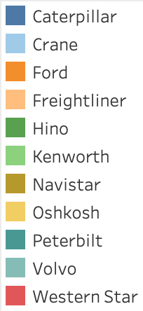
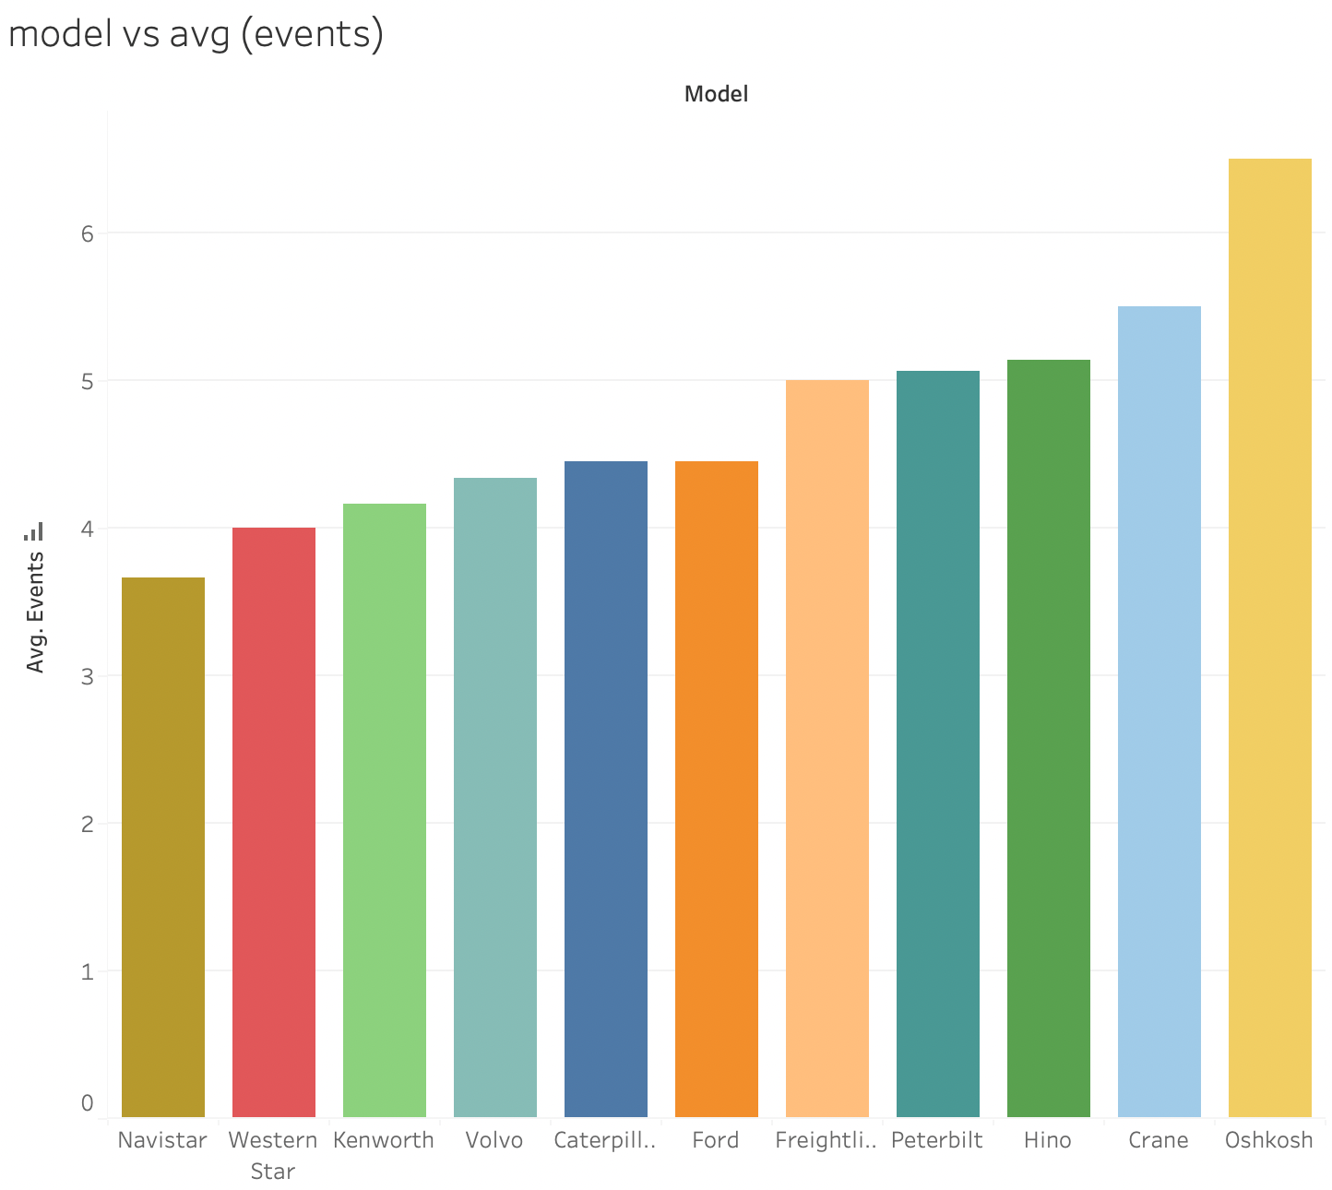
Analysis 6 – Truck model & risk factor
Different truck models have varying frequencies of abnormal events, which results in various degrees of risk factor.

Slide 13
Challenges
Limited knowledge of Tableau
Wanted to leverage ChatGPT's capabilities
Connecting Hadoop with Jupyter Notebook

Slide 14
Turning Challenges into Opportunities
Developed a machine learning model with the help of ChatGPT which in turn calls ChatGPT.
ChatGPT integration for seamless interaction.
Easy-to-use GUI for risk analysis.
Real-time insights and recommendations.

Slide 15
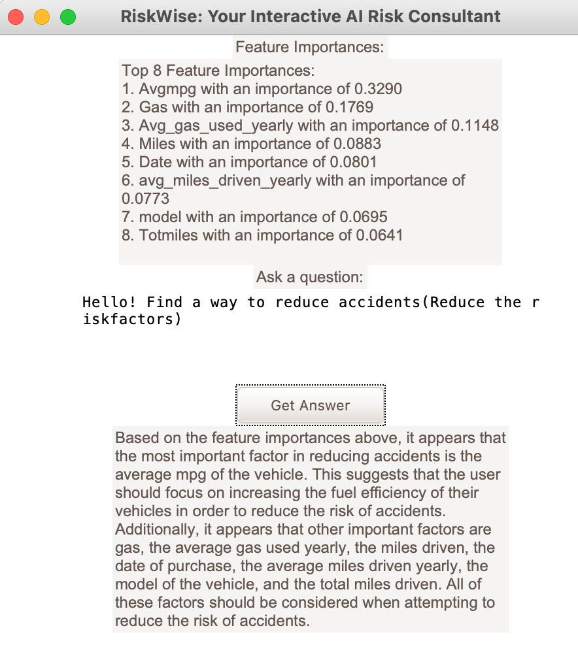
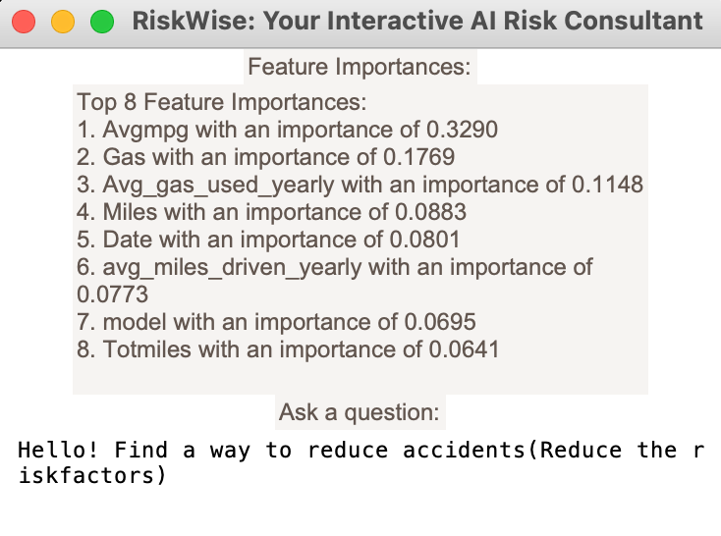
Introducing "RiskWise": Your Interactive AI Risk Consultant

Slide 16
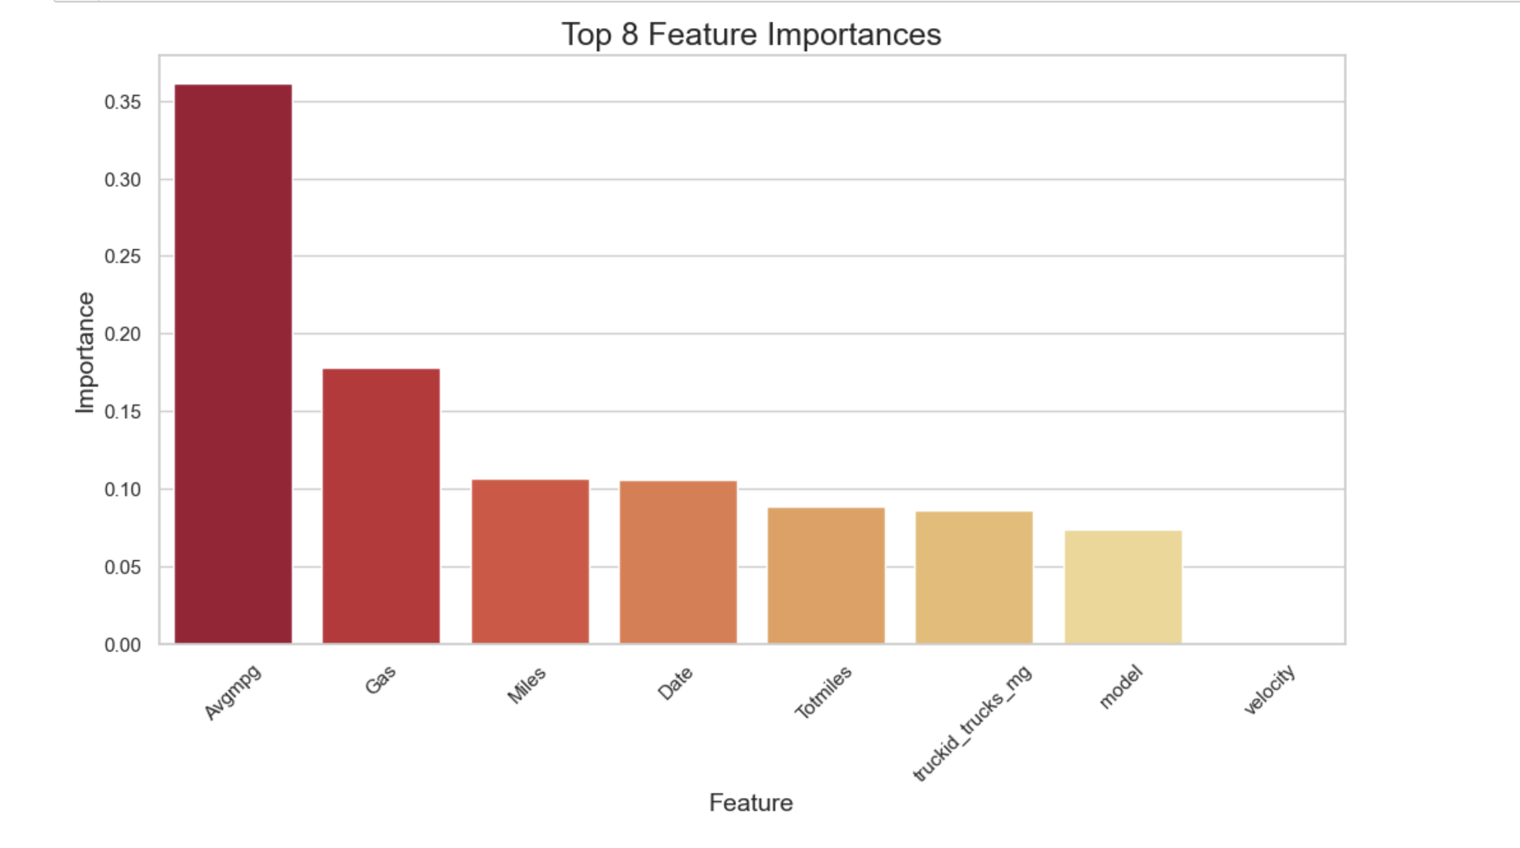
Key Insights - Top 8 Features Impacting Risk Factor from Regression Model

Slide 17
CONCLUSIONS
The top 8 features impacting risk factors are identified: a. Avgmpg (0.3290) b. Gas (0.1769) c. Avg_gas_used_yearly (0.1148) d. Miles (0.0883) e. Date (0.0801) f. avg_miles_driven_yearly (0.0773) g. model (0.0695) h. Totmiles (0.0641)
These features can be used to predict and assess risk factors, ultimately helping to improve driver safety and reduce accidents caused by large commercial trucks.
By focusing on these critical factors, companies can implement targeted interventions to minimize risk and enhance the overall safety of their fleet operations.

Slide 18
THANK YOU!
We kindly ask you to take a moment to rate our
"RiskWise": Your Interactive AI Risk Consultant

